Slide 1
Successfully Transferring Wealth to the Next Generation
Communicate, Engage, Educate
Presenter Title
47015.3
Notes:
I'd like to take a moment to talk about the transfer of wealth and the challenges presented in leaving assets to your children.
Studies have shown that 68% of inheritances fail in the United States due to a lack of clear communication with adult children.¹
¹ Page 6, Bridging Generations: Transitioning Family Wealth and Values for a Sustainable Legacy, by Roy O. Williams & Amy A. Castoro. Copyright 2017.
The question is, how can you best help them wisely manage the estate you've worked so hard to build so that it might last for generations.

Slide 2
This material should be used as helpful hints only. Each person’s situation is different.
MFS® does not provide legal, tax or accounting advice. Clients of MFS should obtain their own independent tax and legal advice based on their particular circumstances.
The views expressed in this presentation are those of MFS and are subject to change at any time. These views should not be relied upon as investment advice, as securities recommendations, or as an indication of trading intent on behalf of any other MFS investment product.
MFS Fund Distributors, Inc. may have sponsored this seminar by paying for all or a portion of the associated costs. Such sponsorship may create a conflict of interest to the extent that the broker dealer's financial advisor considers the sponsorship when rendering advice to customers.
MFS Fund Distributors, Inc., Boston, MA

Slide 3
Agenda
How to communicate with clarity
Four reasons why transfers may fail
Tools and resources to help aid the family wealth discussion
Notes:
In this seminar we will discuss
How to communicate to your children with clarity
The four common reasons why transfers may fail
Lastly, tools and resources to help you engage adult children and communicate more efficiently about your estate, family values and wealth transfer

Slide 4
Communicate With Clarity
Obstacles to communicating
with clarity:
Fear of kids becoming greedy
Concern over kids not striving
Ways to communicate
with clarity:
“What kind of impact do you want your inheritance to make on your children?”
“Here’s what I would like to see you accomplish in your lifetime.”
Notes:
Among the many reasons that we don't want to disclose our financial picture to our children are
We have a fear of our kids becoming greedy.
We want them to continue to try to reach their own defined goals and not stop striving because they think they won't need to work as hard.
What you can do is reframe the conversation:
What kind of impact do you want your inheritance to have on your children?
It is important to communicate with clarity: “Here’s what I would like to see you accomplish in your lifetime”

Slide 5

Why Transfers May Fail
1
Kids don’t have enough experience managing money.
Notes:
Next I will walk you through four reasons why transfers may fail.
1.0 Why Transfers Fail: Kids don't have enough experience managing money. We spend an inordinate amount of time preparing our assets for our heirs and very little time preparing our heirs for our assets. Their first reaction is "I've won the lottery!" Their second reaction is "Holy cow! What do I do now?”

Slide 6

Why Transfers May Fail
2
Kids may fight over what they perceive to be unfair.
Notes:
2.0 Why Transfers Fail: Kids will fight over what they perceive to be unfair. Explain yourself in writing, both legally and informally. You can take advantage of a Letter of Intent, and you can make a video recording for even more clarity.

Slide 7

Why Transfers May Fail
3
Kids will fight over the timing of distributions.
Notes:
3.0 Why Transfers Fail: Kids will fight over the timing of distributions. Consider not naming your alpha/oldest child as the trustee of your estate. It may create in-fighting among kids. Consider naming someone outside your family.

Slide 8

Why Transfers May Fail
4
Kids will fight over the family cottage or home.
Notes:
4.0 Why Transfers Fail: Kids will fight over the family cottage or home.
Let's pretend for a moment that you are all my children. We've had a vacation home since you were kids, and we have spent some time there every summer, even after you were adults and had your own children. All of us have great memories of the home. I want this to continue, so I leave the home to all three of you in equal share.
Now, let’s say one of you lives half an hour away, another of you lives a few hours away and another of you has to take a flight to get there. What does their relationship look like five years from now? We've all seen this happen. The best of intentions lead to the last thing we wanted. It can be avoided with a simple family conversation and having a plan that the family agrees is fair before anything happens. Think harmony. Communication is important to passing on assets of any kind.
Recommend the book Saving the Family Cottage by Stuart J. Hollander, David Fry and Rose Hollander.
MFS® is not affiliated with the authors Stuart J. Hollander, David Fry, and Rose Hollander . These entities/products/links are being provided as a convenience and for informational purposes only; they do not constitute an endorsement or approval by MFS.®

Slide 9

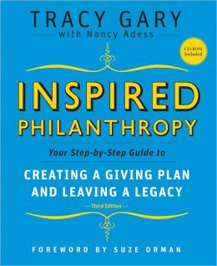

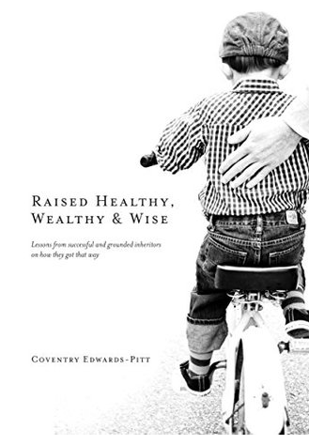
Communicate: Engage and Educate
MFS® is not affiliated with the authors Jim Stovall, Tracy Gary, Nancy Adess, Susan Crites Price, or Coventry Edwards-Pitt . These entities/products/links are being provided as a convenience and for informational purposes only; they do not constitute an endorsement or approval by MFS.®
Notes:
Communicate, Engage, Educate. To become an accomplished skier, pianist or parent, we read books, we practice techniques, we develop competency. It's the same with transferring our wealth successfully to our kids.
Here are a few resource books to help you and your children develop financial and family philanthropic competency:
Inspired Philanthropy is a phenomenal resource tool for helping families define their family values, develop a mission statement and learn more about each others' passions for different groups or organizations. It offers forms, grids, questionnaires, definitions, websites, common family practices, sample giving plans, conversation starters, family meeting agendas, etc.
The Giving Family is fabulous because it provides tactical ideas on how to engage your children in philanthropy. It has ideas for five-year olds (penny drives, book drives, toy drives) as well as for fifty-year-old adult children to help talk about activities and charities that you may want to support as a family.
The Ultimate Gift is for a family that believes they have one child who is wholly incapable of handling an inheritance and how to prepare them.
Raised Healthy, Wealthy and Wise includes interviews with kids who have inherited wealth: "I am so glad my parents did X," and "I wish my parents had done Y."

Slide 10
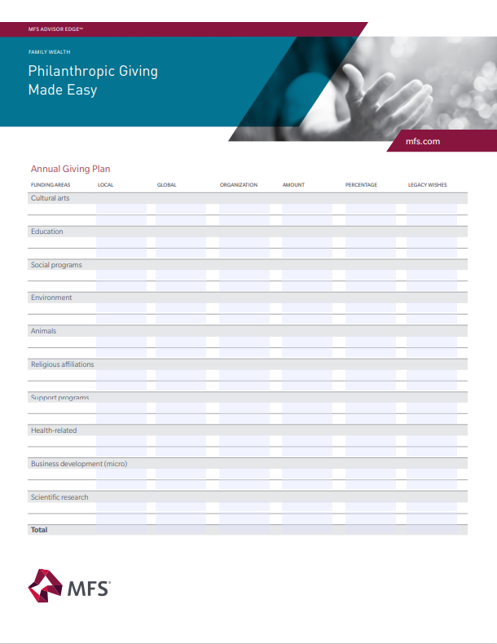
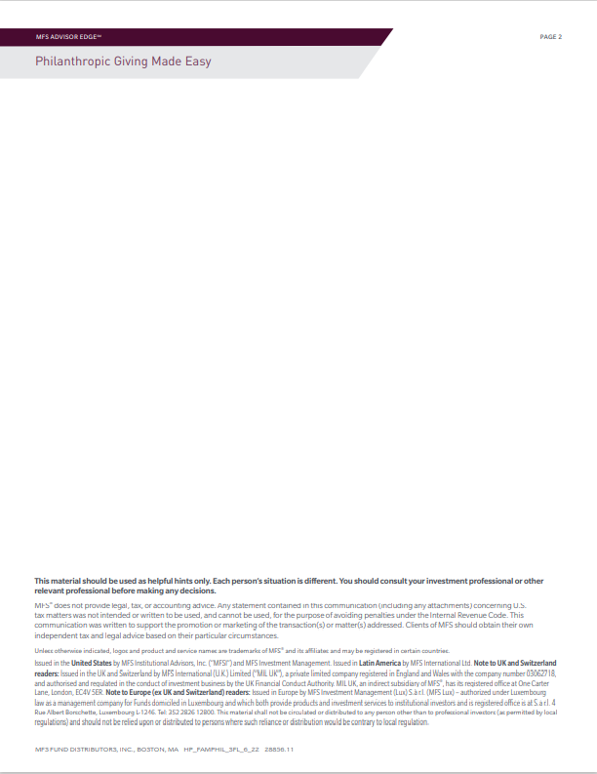
Communicate: Engage and Educate
Use tools to open conversations
Notes:
Communicate, Engage and Educate. Engage your children in a conversation about charitable giving. There are some terrific tools available to you, one of which is this piece, called “Philanthropic Giving Made Easy.” It is designed to help you create a family giving plan and communicate your ultimate wishes while also allowing children to make their own giving wishes known. It enables your family to talk about money and values, without you disclosing your assets.
MFS Code: HP-FAMPHIL-SFL-6/22 28856

Slide 11
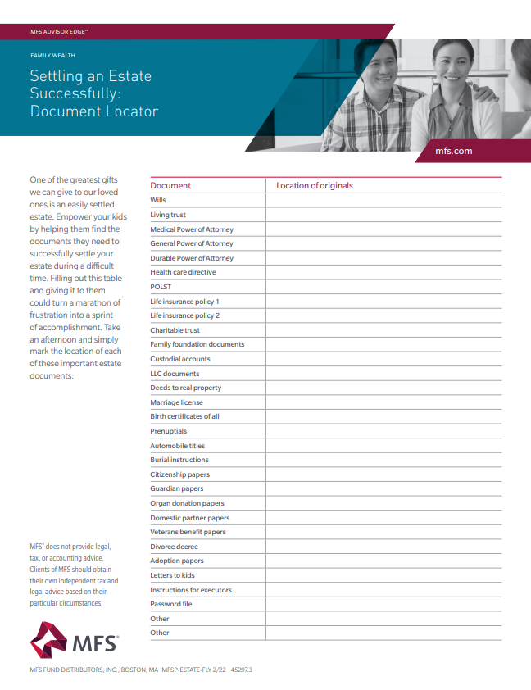
Communicate: Engage and Educate
Use tools to open conversations
Notes:
A document locator such as the “Settling an Estate Successfully” flyer from MFS can help you start a conversation about estate planning. One of the greatest gifts we can give to our loved ones is an easily settled estate. Empower your kids by helping them find the documents they need to successfully settle your estate during a difficult time. Filling out this table and giving it to them could turn a marathon of frustration into a sprint of accomplishment. Take an afternoon and simply mark the location of each of these important estate documents.
MFS CODE: MFSP-ESTATE-FLY 2/22 45297

Slide 12
Communicate: Engage and Educate
Use tools to open conversations
MFS® is not affiliated with the familyloveletter.com. These entities/products/links are being provided as a convenience and for informational purposes only; they do not constitute an endorsement or approval by MFS. ®
Notes:
The Family Love Letter, which can be found online at www.familyloveletter.com, is an invaluable resource for adult kids. This tool will help you engage in conversations about the estate, but again, not assets. This allows you to organize all pertinent information in one place so that settling your estate is not a marathon.

Slide 13
Great Ways to Interact With the Next Generation
Bring children in for an annual review with your financial professional
Money Savvy Generation (moneysavvy.com)
Create a Giving Plan
Organize important documents
The Family Love Letter (familyloveletter.com)
Any time you open an account for a child
Roth IRA funding options and education
1
2
3
4
5
6
7
MFS® is not affiliated with moneysavvy.com or familyloveletter.com. These entities/products/links are being provided as a convenience and for informational purposes only; they do not constitute an endorsement or approval by MFS.®
Notes:
Here is a summary of seven great ways to interact with your children, about money, but not about your assets!
Bring your children in for an annual review with your financial advisor or investment professional.
Moneysavvy.com has great resources.
Create a Giving Plan: Leverage the MFS resource “Philanthropic Giving Made Easy Flyer” (MFS Code: HP-FAMPHIL-SFL-6/22 28856).
Organize/locate important documents: “MFS Settling an Estate Successfully” Flyer (MFS CODE: MFSP-ESTATE-FLY 2/22 45297).
Use tools such as The Family Love Letter (familyloveletter.com) to open up the conversation about your estate.
Any time you open an account for a child.
Roth IRA funding options and education

Slide 14
Thank You
Presenter Title
Notes:
A family's estate, wealth and most importantly a family’s integrity may dissolve post-mortem due to a lack of clear communication. We need to express ourselves, to communicate clearly and to give our children the tools to handle the transfer and the knowledge to handle it successfully.
I want to encourage you to pick one of the ideas that we discussed today and work with your financial advisor or investment professional.

